Slide 1

Austin Texas Zip Code Analysis
ERIN ALWON

Slide 2
“Austin is the state capital of Texas, an inland city bordering the Hill Country region. Home to the University of Texas flagship campus, Austin is known for its eclectic live-music scene centered around country, blues and rock. Its many parks and lakes are popular for hiking, biking, swimming and boating. South of the city, Formula One's Circuit of the Americas raceway has hosted the United States Grand Prix.”
- GOOGLE

Slide 3
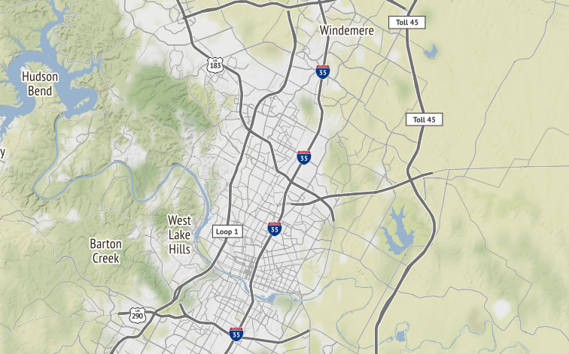
In such a beautiful city, how do you start determining where to live?

Slide 4
Each person has a unique list of what is most important to them
Crime
Growth Rate
Cost of Living
Local Venues

Slide 5
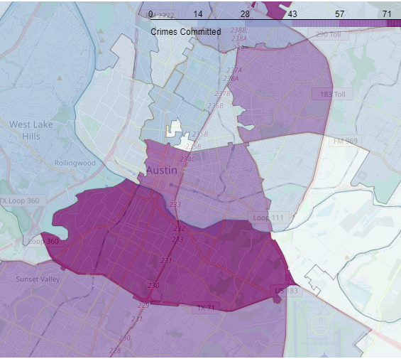
Crimes by Zip Code
Although the crime rates are relatively low across all areas we can see the areas with the highest number of crimes reported are just south of downtown and much further north, all along the freeway.

Slide 6
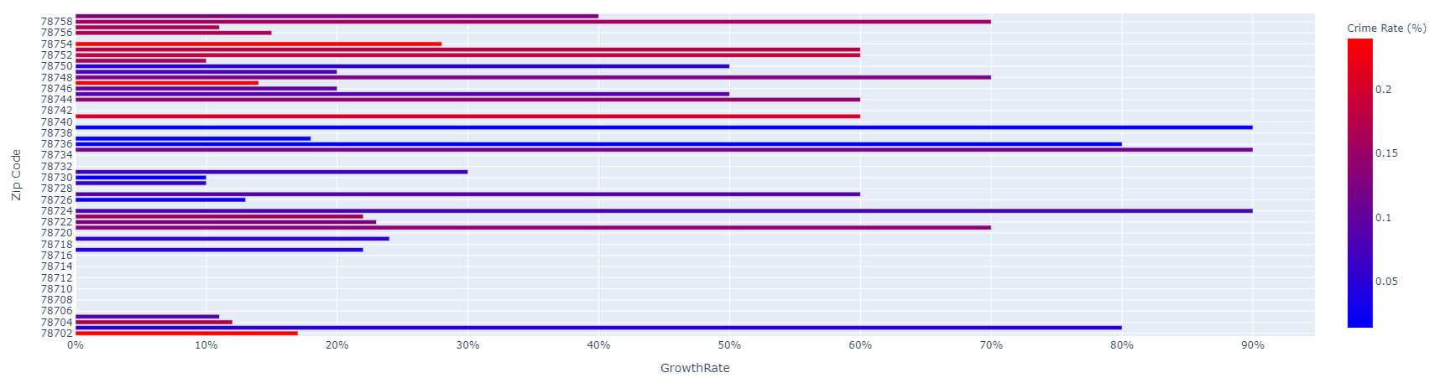
Crime Rate vs Growth Rate: If a client is interested in a high growth, low crime area they should look at the longer blue lines of the chart

Slide 7
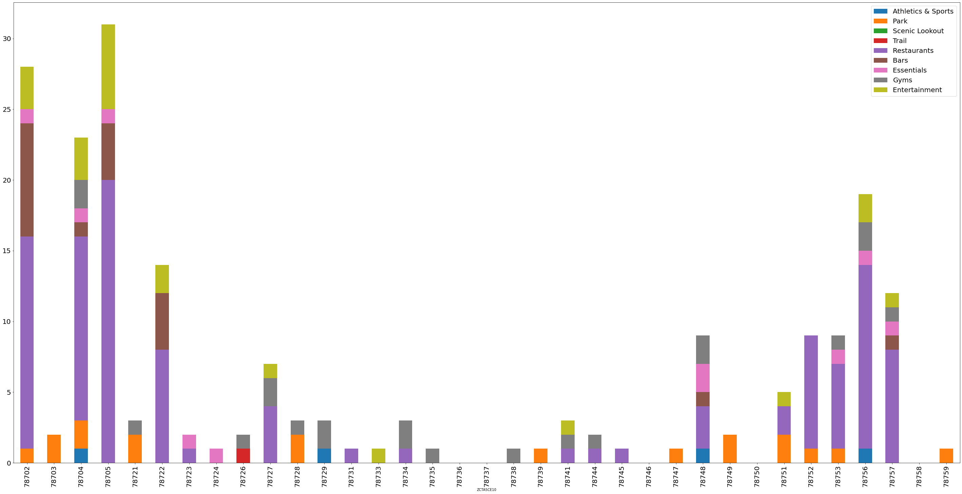
Venues vary greatly by zip code, this could be a key to finding the right location for a given person

Slide 8
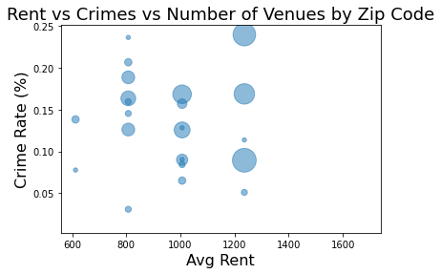
Rent vs Crime Rates vs Number of Venues
As might be expected the number of venues was higher in areas with higher average rent. However, the crime rate did not seem to vary much based on rent nor number of venues. In fact some of the lowest crime rates were associated with the lowest rents and fewest venues (as noted in the purple square).
This chart could be very useful in narrowing down zip codes of interest. For example if you want rent around $1000 but a large variety of venues you could look at the area in the blue square. If you want more venues but low crime look at the area in the green square.

Slide 9
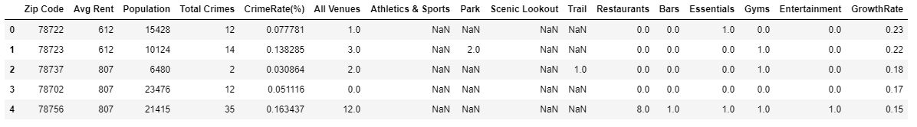
Combining the above – using the above to have a client choose their favorite zip codes you can then re-run graphs or compare the raw data for these zip codes to help make a decision as to where to live based on what is most important to them and their unique needs and wants

